Slide 1

Corona
Virus
Analysis
with
SQL
BY
Akshaya.G
BATCHNAME: MIP-DA-09

Slide 2
Dataset:
Description of each column in dataset:
Province: Geographic subdivision within a country/region.
Country/Region: Geographic entity where data is recorded.
Latitude: North-south position on Earth's surface.
Longitude: East-west position on Earth's surface.
Date: Recorded date of CORONA VIRUS data.
Confirmed: Number of diagnosed CORONA VIRUS cases.
Deaths: Number of CORONA VIRUS related deaths.
Recovered: Number of recovered CORONA VIRUS cases.

Slide 3
Creating the table
Create table corona_virus (Province varchar (60),Country/Regionvarchar(60),Latitude int,Longitude int,Dates date , Confirmed int, Deaths int ,Recovered int);
TABLE name: corona_virus

Slide 4
Questions
Q1. Write a code to check NULL values
Q2. If NULL values are present, update them with zeros for all columns.
Q3. check total number of rows
Q4. Check what is start_date and end_date
Q5. Number of month present in dataset
Q6. Find monthly average for confirmed, deaths, recovered
Q7. Find most frequent value for confirmed, deaths, recovered each month
Q8. Find minimum values for confirmed, deaths, recovered per year
Q9. Find maximum values of confirmed, deaths, recovered per year
Q10. The total number of case of confirmed, deaths, recovered each month

Slide 5
Q11. Check how corona virus spread out with respect to confirmed case -- (Eg.: total confirmed cases, their average, variance & STDEV )
Q12. Check how corona virus spread out with respect to death case per month -- (Eg.: total confirmed cases, their average, variance & STDEV )
Q13. Check how corona virus spread out with respect to recovered case -- (Eg.: total confirmed cases, their average, variance & STDEV )
Q14. Find Country having highest number of the Confirmed case
Q15. Find Country having lowest number of the death case
Q16. Find top 5 countries having highest recovered case

Slide 6
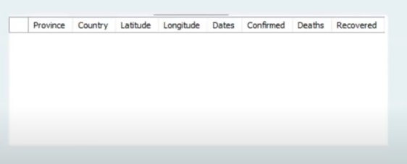
SQL QUERIES
Q1. Write a code to check NULL values
Select * from corona_virus
Q2. If NULL values are present, update them with zeros for all columns.
Select * from corona_virus where ‘Province’ is NULL OR ‘Country/Region’ is NULL OR ‘Latitude’ is NULL OR ‘Longitude’ is NULL OR ‘Date’ isNULL OR ‘Confirmed’ is NULL,’ Deaths’ is NULL OR ‘Recovered’ is NULL
# no null values ARE present in the entire table

Slide 7
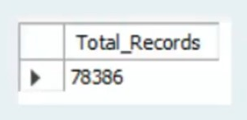


Q3. check total number of rows
SELECT COUNT(*) AS Total _Records from corona_virus
Q4. Check what is start_date and end_date
SELECT MIN(Date) AS start_date, MAX(Date) AS end_date FROM corona_virus;
Q5. Number of month present in dataset
SELECT count(distinct (month(dates)) AS num_month from corona_virus

Slide 8
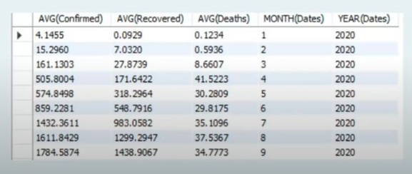
Q6. Find monthly average for confirmed, deaths, recovered
SELECT
AVG(Confirmed ),
AVG(Recovered),
AVG(Deaths) ,
MONTH(Dates) ,
YEAR(Dates)
FROM corona_virus
GROUP BY MONTH(Dates) ,YEAR(Dates);

Slide 9

Q7.Find most frequent value for confirmed, deaths, recovered each month
SELECT
EXTRACT(MONTH FROM Date) AS MONTH
max (confirmed) AS most_frequent_confirmed,
max (Deaths) AS most_frequent_deaths,
max (Recovered) AS most_frequent_recovered
FROM
corona_virus
GROUP BY
EXTRACT(MONTH FROM Date);

Slide 10

Q8. Find minimum values for confirmed, deaths, recovered per year
SELECT
EXTRACT(YEAR FROM date) AS year,
MIN(Confirmed) AS min_confirmed,
MIN(Deaths) AS min_deaths,
MIN(Recovered) AS min_recovered
FROM
corona_virus
GROUP BY
EXTRACT(YEAR FROM Date);

Slide 11

Q9. Find maximum values of confirmed, deaths, recovered per year
SELECT
MAX(confirmed) ,
MAX(deaths) ,
MAX(recovered)
FROM
corona_virus
GROUP BY YEAR (Dates);

Slide 12
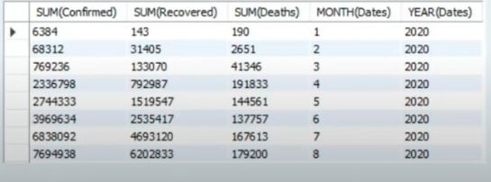
Q10. The total number of case of confirmed, deaths, recovered each month.
SELECT
SUM(Confirmed) ,
SUM(Recovered) ,
SUM(Deaths) ,
MONTH ( Dates) ,
YEAR (Dates)
FROM
corona_virus
GROUP BY MONTH ( Dates). YEAR (Dates);

Slide 13
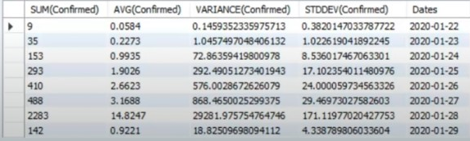
Q11. Check how corona virus spread out with respect to confirmed case (Eg.: total confirmed cases, their average, variance & STDEV )
SELECT
SUM(confirmed) ,
AVG(confirmed),
VARIANCE(confirmed),
STDEV(confirmed),
Dates
FROM
corona_virus
GROUP BY Dates;

Slide 14
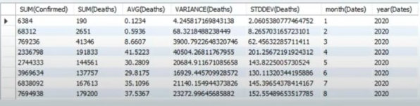
12. Check how corona virus spread out with respect to death case per month (Eg.: total deaths cases, their average, variance & STDEV )
SELECT
SUM(Confirmed) ,
SUM(deaths),
AVG(deaths),
VARIANCE(deaths),
STDEV(deaths),
MONTH (date) ,
YEAR (Dates)
FROM
corona_virus
GROUP BY MONTH (Dates) , YEAR (Dates);

Slide 15
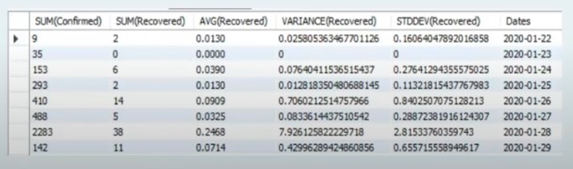
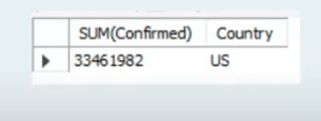
Q13. Check how corona virus spread out with respect to recovered case (Eg: total confirmed cases, their average, variance & STDEV
SELECT SUM (Confirmed), SUM(Recovered), AVG(Recovered) , variance (Recovered) , STDEV (Recovered) , dates from corona_virus GROUP BY Dates;
Q14. Find Country having highest number of the Confirmed case
SELECT
country_region,
SUM(confirmed) AS total_confirmed
FROM corona_virus
GROUP BY country_region
ORDER BY total_confirmed DESC
LIMIT 1;

Slide 16

Q15. Find Country having lowest number of the death case
SELECT
country_region,
SUM(deaths) AS total_deaths
FROM corona_virus
GROUP BY country_region
ORDER BY total_deaths ASC
LIMIT 1;

Slide 17
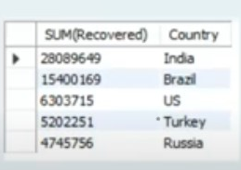
Q16. Find top 5 countries having highest recovered case
SELECT
country_region,
SUM(recovered) AS total_recovered
FROM corona_virus
GROUP BY country_region
ORDER BY total_recovered DESC
LIMIT 5;

